Slide 1
The ecophysiological consequences of light variability
February 9, 2021

Slide 2
How does light availability to plants vary over space and time?

Slide 3
Light effects on short-term plant functioning

Slide 4
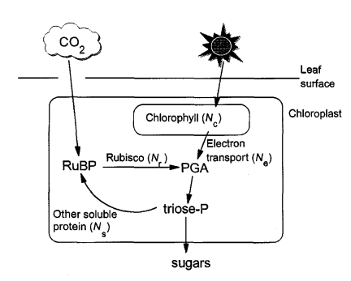
Plants use light to make energy for photosynthesis
Medlyn 1996

Slide 5
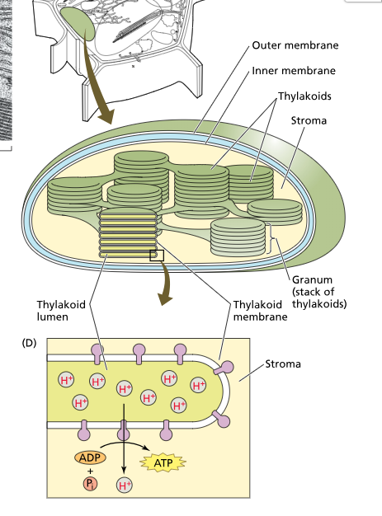
Chloroplasts
Light reaction proteins and pigments are embedded in the thylakoid membrane

Slide 6
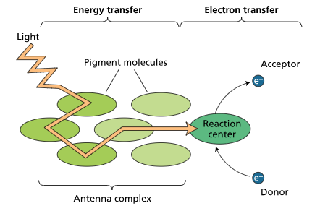
Chlorophyll
Chlorophyll pigments absorb light and create usable energy in the form of NADPH and ATP

Slide 7
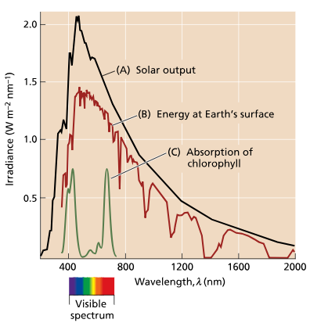
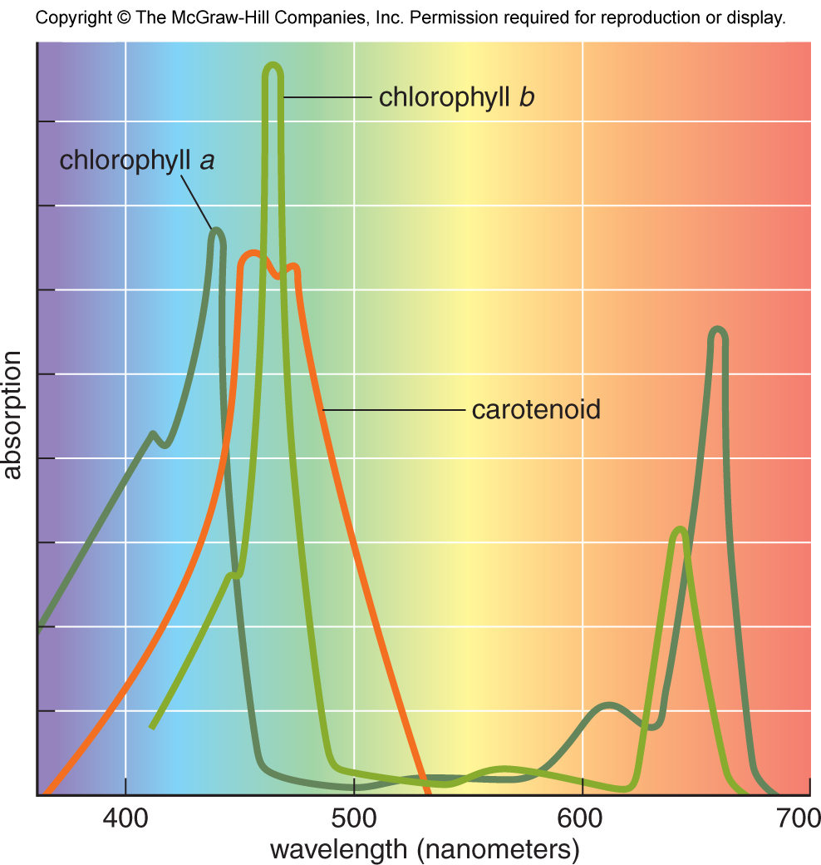

Slide 8
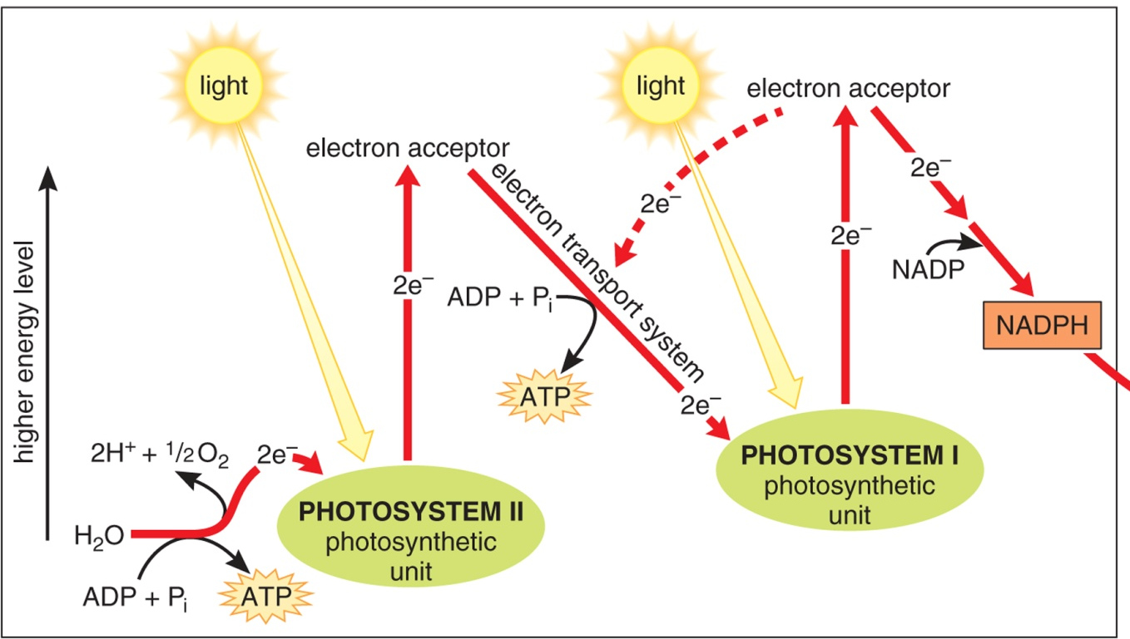
Light-dependent reactions
Ingredients
Light
H2O
NADP+
ADP
P
Outcomes
ATP
NADPH
O2
H+
Bidlack and Jansky (intro botany)

Slide 9
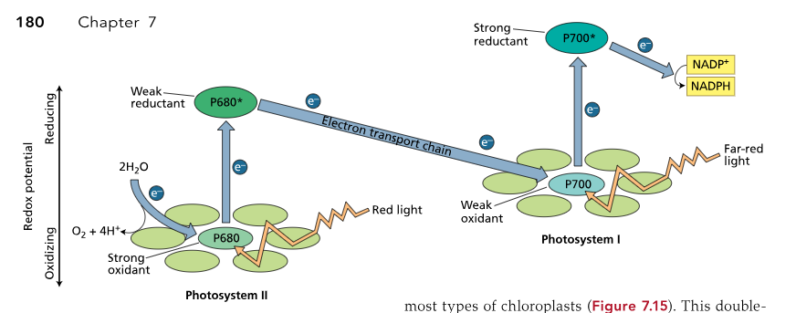
Light-dependent reactions
Ingredients
Light
H2O
NADP+
ADP
P
Outcomes
ATP
NADPH
O2
H+
Pons et al. (plant physiology)

Slide 10
Light-dependent reactions
Ingredients
Light
H2O
NADP+
ADP
P
Outcomes
ATP
NADPH
O2
H+
Wikipedia

Slide 11
The light response of photosynthesis

Slide 12
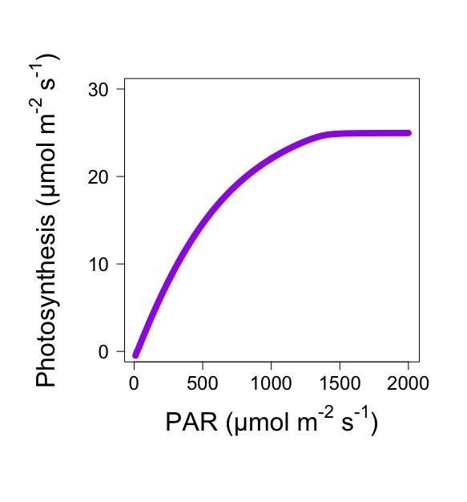

Slide 13
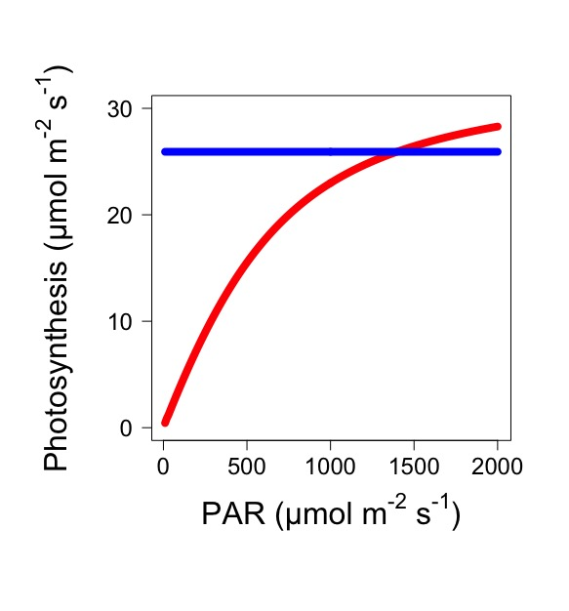
Electron transport limited
Rubisco limited

Slide 14
Light effects on long-term plant functioning - acclimation

Slide 15
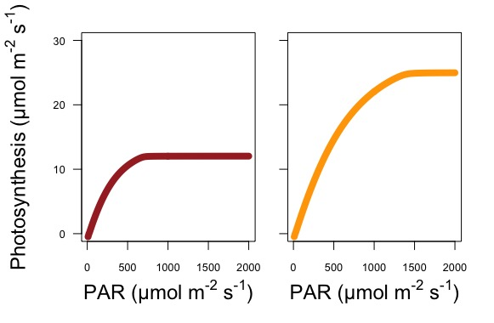
Low light acclimated
High light acclimated

Slide 16
What’s happening here?
Low light acclimated
High light acclimated

Slide 17
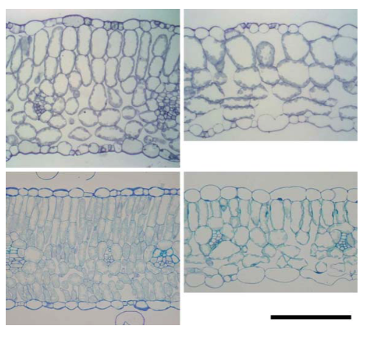
Sun leaves are thicker
Sun
Shade

Slide 18
Sun leaves are thicker – why?
Sun
Shade

Slide 19
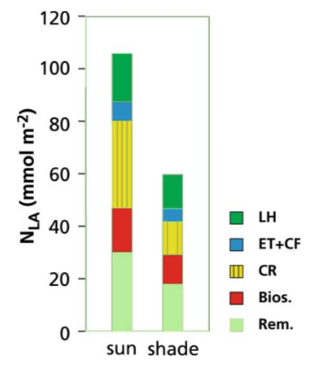
Sun leaves have more N invested in photosynthesis
Light harvesting (chlorophyll)
Electron transport
Rubisco
Biosynthesis (e.g., DNA)
Other (e.g., respiration)

Slide 20
Sun leaves have more N invested in photosynthesis – why?
Light harvesting (chlorophyll)
Electron transport
Rubisco
Biosynthesis (e.g., DNA)
Other (e.g., respiration)

Slide 21
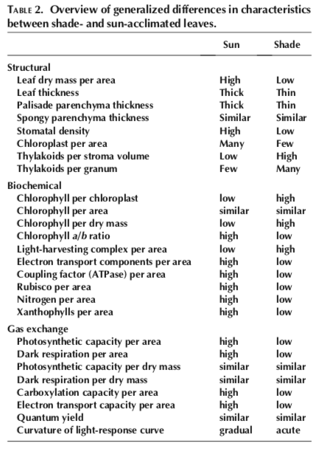
Other differences
Why??
Activity: pick a trait and formulate a hypothesis to explain the observed response

Slide 22
Photoinhibition

Slide 23
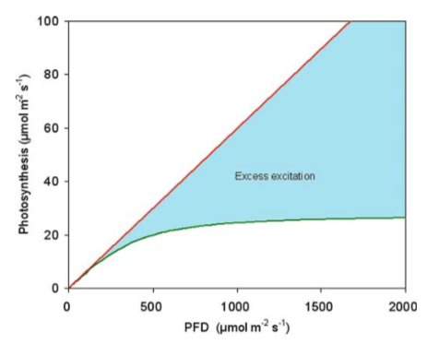
Photoinhibition
Light coming in
Light being used

Slide 24
Photoinhibition
Light coming in
Too much excitement!
Light being used

Slide 25
Photoinhibition
Excess energy is not dissipated, leading to the creating of ROS that damage photosynthetic complexes, reducing photosynthesis

Slide 26
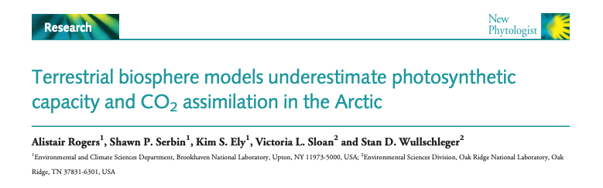
Translation: lots of Rubisco in the arctic!!
Why might this be the case?

Slide 27
How does light availability to plants vary over space and time?

Slide 28
Seasons

Slide 29
Bauerle et al. (2012)

Slide 30
Summer
solstice
Bauerle et al. (2012)

Slide 31
Sunflecks

Slide 32
Sunflecks

Slide 33
Sunflecks
Induced refers to prior exposure to a sunfleck
Way & Pearcy (2012)

Slide 34
Light competition

Slide 35
Light is the most strongly fought-after aboveground resource

Slide 36
So why aren’t plants taller?

Slide 37
Can an individual plant be sun and shade adapted?

